Slide 1
Building WPF GUIs in PowerShell
Stephen Owen
Automation Engineer
Wells Fargo
Scott Corio
Infrastructure Architect
Mallinckrodt Pharmaceuticals

Slide 2
Stephen Owen
Scott Corio
@FoxDeploy
@ScottCorio
Automation Nerd
Beer Nut
Ask me about my first script!
QBASIC
Will do anything for beignettes
I have beignettes and Klondike Bars
Notes:
Stephen first
Nathan second

Slide 3
What the wpf?
Object based GUIs
XAML Based GUIs
HTML PowerShell GUIs
Notes:
What we’ll cover

Slide 4
Why Create A Gui?
WHY THE WPF?!

Slide 5
Why Create a GUI?
Empower your coworkers
Let someone else drive
Ensure things are done the right way
It’s the right tool for the job

Slide 6
A Repeatable Process!
Common ‘First-GUI’ Ideas
Password Resets
Provision new users
Babysitting tasks
Setting a computer name in OSD Task Sequence

Slide 7
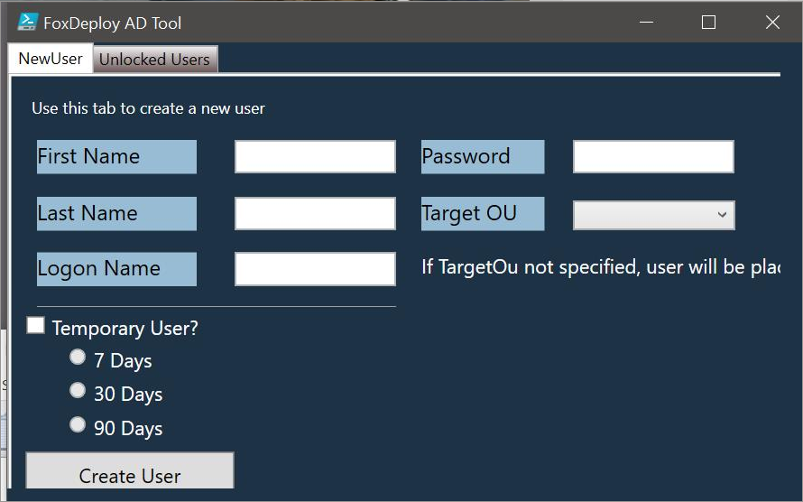
A Repeatable Process!

Slide 8
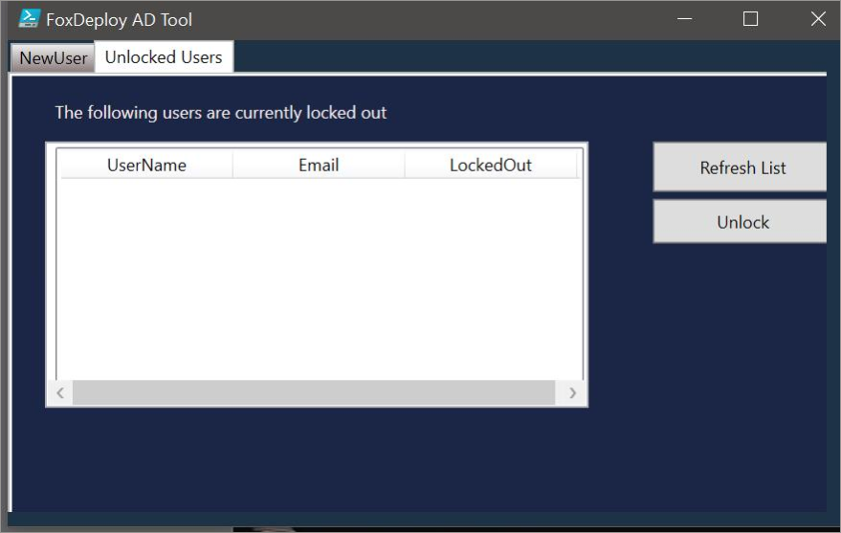
A Repeatable Process!

Slide 9
Show of Hands
Built a GUI in PowerShell?
Familiar with WinForms (the Sapien GUI method)?
Familiar with WPF?
Expert Level WPF Knowledge?
Notes:
SCRIPT
--------
By a show of hands, who has built a GUI in PowerShell? *WAIT*
By a show of hands, who is familiar with WinForms? *WAIT* If you're building GUIs in Sapien PowerShell Studio this would be you to at least a certain degree.
By a show of hands, who is familiar with WPF? *WAIT*
By a show of hands, who has expert level WPF knowledge? *WAIT* Maybe you can come teach the session for us?

Slide 10

By The End Of This Session
Notes:
The goal by the end of this session, is to get you WinForms holdouts to look at the new hotness which is WPF today and will probably be something else another day, but right now – it's WPF.
It's like we're trying to convince those of you still using VBScript to look at PowerShell. In more way than one.
Also if you're still using VBScript.
Really?

Slide 11
Basics of WPF
Notes:
Okay – let's cover some basics of WPF. I know these are supposed to be level 300/400 sessions here, but technically while this is probably level 100 C#, using WPF in PowerShell is definitely level 300+.

Slide 12
WPF Overview
Windows Presentation Framework
UI Framework
Advantages over WinForms
Look and Feel
Layouts
Community Themes/Controls
Damien Van Robaeys (@syst_and_deploy) | http://www.systanddeploy.com/
Animations!
FREE TOOLS!!!
Notes:
NOTES
--------
The "Animations!" line should have some funky animation because why not? ☺ OUTLINE/ROUGH SCRIPT
----------
WINDOWS PRESENTATION FRAMEWORK: WPF stands for Windows Presentation Framework. It was introduced with… drumroll…
.NET freaking 3.0. 2006. What are we at now, like .NET 4.7? Windows 7 shipped with .NET 3.5, so you can basically use it anywhere. If you use it in WinPE there are some special considerations, but we'll get to those later.
UI FRAMEWORK: WPF is a UI framework for Windows Desktop Applications that is a subset of the .NET Framework. It offers some advantages over the more traditional UI framework that many of you might be familiar with; WinForms. What is a UI framework? Well, it's essentially code that writes code for you. Without a framework you would be drawing controls like buttons manually; with a framework you would just add a "button" element and the framework would handle drawing the outline of the button, filling the color of the button, adding the text to the button, changing the color of the button when you hover or click on it, defining an event when the mouse clicks the button, etc.
ADVANTAGES OVER WINFORMS: WPF offers a few different advantages over WinForms – one big one specifically is that many of the "controls" (e.g. button, TextBlock, etc) have no official "look" defined. With WPF you could put a picture inside of a button instead of text, whereas this is not possible with WinForms without defining your own "Image Button" control or getting a 3rd party control that supports it. Also instead of being tied to a graphical editor or *GASP* writing your own objects in code, you can write your UI in XAML (which looks a lot like XML).
Layouts are much more friendly to generate in WPF as well. Using controls like "Grid" and "StackPanel" you can intelligently layout your controls rather than specifying a pixel location (yuck).
Additionally there are a few great themes and custom controls available for FREE from the community. These include full theme replacements like MahApps.Metro or Material Design, or even just custom controls that you can use to enhance your scripts. I would suggest following Damien Van Robaeys on Twitter or visiting his blog as he shares many of these controls and themes (as well as their use in PowerShell) on a regular basis.
While you probably won't end up using them directly in PowerShell (or maybe you will – I'm not going to stop you), animations are super easy to define for controls in XAML.
FREE TOOLS: I have nothing but high praise to give products like Sapien's PowerShell Studio, but I'm also suuuuuuper cheap. Designing a GUI in a WYSIWYG editor is free with WPF – Visual Studio Community Edition can help you design your XAML that will later be imported to the PowerShell script. It also has the added benefit of giving you a platform to learn a new language like C#.
Although there are some potential licensing pitfalls with using Visual Studio CE – I'm not a lawyer, _____ is not a lawyer, so you should check with your lawyers.

Slide 13
XAML Structure
eXtensible Application Markup Language
Parent/Child relationship with properties
XAML executes no code (no PowerShell, no C#, etc)
Notes:
Okay, so we keep talking about this XAML thing – what is it? eXtensible Application Markup Language. It's XML with a few minor changes.
You have a main element like a window with properties attached to that element, and you also have child elements like grids, or buttons, attached to that parent or even to children (nesting for the win).
The important thing to note here is that XAML doesn't use any "code" – it's all elements. So animations aren't defined as code – they're defined as elements in a storyboard. I know this distinction seems minor, but when you go a bit deeper in XAML it becomes more important. Like if you needed to convert a value into a different format – there isn't a way to convert 3244 into 32.44 degrees Fahrenheit in XAML – you require some bit of code behind or a value converter to do that – well outside the scope of this presentation, but good to know nonetheless.

Slide 14
Good Bad Layout Hygiene
Direct Drag and Drop
Leads to element positioning defined by pixel in margin attribute (i.e. there isn't really an "absolute" positioning attribute in WPF)
Does not scale well
Issues arise when you nest elements like StackPanels in Grids (Visual Studio ends up placing them in the parent element)
They're all gonna laugh at you.
Notes:
Here's the deal – drag and drop leads to a few problems.
It means that elements like buttons are defined by margin pixels. There is no way to "absolutely" position an element in XAML so the fallback is to define a margin for the element which effectively accomplishes the same thing, but not really.
It doesn't scale well. If you rely on positioning via pixel you're going to have a bad time when you run the script on a monitor with a different DPI scale or font size. The chances of this happening might be slim, but they're worth considering.
Also – if I see any of you writing a script in WPF and posting it to GitHub and I see remnants of drag and drop – I'm gonna laugh at you, then provide some constructive feedback to help you re-organize your XAML.

Slide 15
Good Layout Hygiene
Grids
Similar to HTML tables
Row/Column sizes defined in three formats:
Proportional Division (Star/*)
Pixels
Automatic sizing based on content
StackPanel
Kind of like "Automatic Tables"
Elements/Controls "stack" horizontally/vertically
Notes:
GOOD layout hygiene uses either Grids, StackPanels, or some combination of those two layout elements.
Grids are similar to HTML tables – you have rows and columns. They can be defined by proportional division (meaning "take up 1/3 of the remaining space"), they can be define as specific pixel heights/widths, or you can automatically size them based off of content. They're rather versatile but do require a bit of manual work to define up front.
StackPanels on the other hand are kind of like Automatic tables. Elements or controls stack horizontally/vertically based on the amount of space (horizontal or vertical) which they request.

Slide 16
Creating WPF Dialogs in PowerShell Using Objects
aka straight PowerShell…
aka the “Sapien” WinForms method…
Notes:
Now that we've got the basics out of the way let's talk about creating WPF dialogs in PowerShell using object
Aka straight PowerShell, no chaser…
Aka the "Sapien" WinForms method you might be familiar with…
Aka…

Slide 17
aka The HARD Way
Notes:
THE HARD WAY.
Seriously, I use this on some very basic WPF elements to make it easier to comprehend for my clients who are XAML adverse, but it typically ends up meaning more code and not necessarily more readable code.

Slide 18
Structuring Your PowerShell
Add the Framework(s)
Notes:
So the first thing we need to do if we're going to build the code manually is import our frameworks. You'll have to do this with the XAML method too, just FYI.

Slide 19
Add The Framework(s)
## PresentationFramework / PresentationFramework.dll contains all of the WPF controls ## that are necessary to build our GUI.
Add-Type -AssemblyName PresentationFramework
## You may SOMETIMES see the following referenced in other PowerShell scripts. These ## should never be required to create WPF GUIs with objects in PowerShell, and also ## shouldn't be required if you're using the XAML method either.
Add-Type -AssemblyName PresentationCore Add-Type -AssemblyName WindowsBase
Notes:
Pretty much you only need to run "Add-Type – AssemblyName PresentationFramework"
The other two that you might see from time to time in other scripts are PresentationCore and WindowsBase. To date, I have not found a particular use for these two types that would translate to a need in PowerShell. I think there is the possibility that some of the base types like a "SolidColorBrush" may require PresentaitonCore, a good rule of thumb is if it compiles, runs, and looks correct without adding these two types, then you can safely exclude them. Although including them probably won't cause you much headache either.

Slide 20
Structuring Your PowerShell
Add the Frameworks
Create Your Objects (Window, Buttons, Labels, Grids, You Get the Picture)
Notes:
Next we need to create all our objects – like windows, buttons, labels, grids, oh my.

Slide 21
Create Your Objects
$Window = New-Object System.Windows.Window $Window.Height = 600 $Window.Width = 400 $Window.Title = "Big Surprise" $Window.ResizeMode = "NoResize"
$StackPanel = New-Object System.Windows.Controls.StackPanel
$Surprise = New-Object System.Windows.Controls.Image $Surprise.Source = "$PSScriptRoot\xx-Surprise.jpg" $Surprise.Visibility = "Hidden" $Surprise.Height = 500
$Button = New-Object System.Windows.Controls.Button $Button.Content = "How you doin?" $Button.Height = 50 $Button.Width = 100
Notes:
First we'll create a window object – this is a type of "System.Windows.Window" and store it in a variable.
We can then reference the properties of that object and set things like the height/width, or title of the window.
Next we'll create a stack panel.
Next we'll create a child object – why don't we create an image, but we'll make it a surprise, so it's visibility will be hidden when we start the script.
Finally, we'll create a button to reveal the surprise.

Slide 22
Structuring Your PowerShell
Add the Frameworks
Create Your Objects (Window, Buttons, Labels, Grids, You Get the Picture)
Add Your Child Objects to Their Parent
Notes:
Okay, now we need to add child object into their respective parents. Take mind to the order you apply them for things like StackPanel.

Slide 23
Add Your Children
## Parent objects accept a couple different ways to add content depending on which ## control the parent object is. These include: ## - $Object.Content = $Child ## - $Object.AddChild($Child)
$StackPanel.AddChild($Surprise) $StackPanel.AddChild($Button)
$Window.Content = $StackPanel
Notes:
Again – pay attention to the order here – we're adding things vertically in the stack panel, so the first object we add will be put at the top of the stackpanel, etc.
Also pay attention to the ways that the content is added. In most cases, controls that support multiple children (like grids or stackpanels) will have an "AddChild" method, whereas controls that only support one child typically have a property called "Content"

Slide 24
Structuring Your PowerShell
Add the Frameworks
Create Your Objects (Window, Buttons, Labels, Grids, You Get the Picture)
Add Your Child Objects to Their Parent
Add Your Events
Notes:
Next we need to wire up our events.

Slide 25
Add Your Events
## Events are added by getting the name of the event and prepending "Add_" to it. ## - $Object.Add_Click({event script block}) ## ## You can get the list of available events by creating the object in PowerShell and ## then running the Get-Member cmdlet against it: ## - $Object | Get-Member -MemberType Event
$Button.Add_Click( { $Surprise.Visibility = "Visible" } )
Notes:
All of the events that you will likely use are added by prepending "Add_" to the name of the event. Buttons for example would be Add underscore Click. You can get a list of all available events by newing up the control in a PowerShell variable and running the Get-Member cmdlet against it.
In our case, we're telling the button to make the surprise visible.

Slide 26
Structuring Your PowerShell
Add the Frameworks
Create Your Objects (Window, Buttons, Labels, Grids, You Get the Picture)
Add Your Child Objects to Their Parent
Add Your Events
Show the Dialog
Notes:
F

Slide 27
Show Your Dialog
## By prepending "$null =" to our ShowDialog() method we won’t get the Boolean output ## of the ShowDialog() method. $null = $Window.ShowDialog()
Notes:
We prepend "$null = " to the ShowDialog method to keep the Boolean output from showing up in the PowerShell console. It's totally not necessary, but if you want a clean console, this is the way to do it.

Slide 28
Straight PowerShell.
No Chaser.
Notes:
Okay – straight powershell, no chaser. Let's take a look at the script that we just wrote.
HEY DUDE – REMEMBER TO SET EXPLORER TO DETAILS VIEW RATHER THAN ICONS TO NOT SPOIL THE SURPRISE.

Slide 29
pro et contra
Pros
Cons
Familiar language (if you used to build GUIs with Sapien or a similar WYSIWYG editor)
It’s good to learn your roots
No WYSIWYG Editors that will generate the object code (AFAIK)
Requires an existing knowledge of WPF controls and their attributes
Responsive GUIs are much harder to create (as if they weren't hard enough already)
Complex GUIs are hard to design and super verbose
Lots of lines of code very quickly
Notes:
Pros and Cons.
Pros – it looks familiar if you're used to building GUIs with Sapien or a similar WYSIWYG editor for WinForms. It's also good to learn your roots in how XAML works.
However, there are a significant number of cons here. There are (as of the time of this presentation at least) no WYSIWYG editors that will generate native/object code. It also requires an existing knowledge of WPF controls and their attributes (although you can always have fun with Get-Member for the attributes).
Additionally it grows quickly in lines of code – the same thing that you might be able to define in line in XAML might require more lines of code in native PowerShell.
If you care about responsive GUIs (meaning GUIs that don’t freeze when you run some long running query or cmdlet – also, you should care about responsive GUIs), they are harder to create in native code than the XAML experience – and they're already hard enough to build in PowerShell with XAML.
Finally – complex GUIs are hard to design and again – super verbose – so lots of lines of code.
I pretty much reserve my use of this to like dialogs with a single input and a button like a "computer name" dialog or something like that.

Slide 30
Creating WPF Dialogs in PowerShell Using XAML
Jazzled about XAML

Slide 31
Making a WPF UI - FLow
Design your User Interface in Visual Studio
Copy XAML
Paste XAML into new file
Load Parse XAML
Write Event Handlers
Give to end users to run
Wait, WPF is XAML?

Slide 32
Wait… WPF is XAML?

Slide 33
The XAML Way.
Notes:
Here we go to vs and make a UI in XAML, copy and paste into PowerShell and boom it workie

Slide 34

Options
"You can GO YOUR OWN WAY! (go your own waaaaay)"
Visual Studio Blend
Use a community theme / control. Examples include:
MahApps.Metro
Material Design
Notes:
(wait for audio to play)
You can go your own way – Visual Studio Blend is designed to allow you to customize the look and feel of your own controls.
However, in my line of business my client's aren't typically paying me to make things look pretty so I rely on pre-built frameworks/themes like MahApps.Metro or Material Design. It's a matter of preference what you choose – there's no right or wrong answer here.

Slide 35
Community Themes
Download / collect the appropriate resource libraries (DLLs)
NuGet + 7-Zip
Visual Studio
Design GUI based on theme
Add resources references to XAML via resource dictionary
In some cases you may need to modify the base element (Window)
*cough* MahApps *cough*
Import DLL(s) in PowerShell script
Notes:
To use community themes you'll need to take three steps:
You have a couple of options when it comes to Community Themes. You can collect and download all the appropriate resources from NuGet and then use 7-zip to extract them, or you can create a blank C# WPF application in visual studio and then use NuGet to get the resources and the dependencies. I would personally recommend the latter solely because if you download from NuGet directly you might not know the dependencies which are required by the package.
You need to design the GUI based on the theme, by adding them as resource references in XAML, and in some cases you might need to modify the base element *cough* MahApps Metro *cough*
Finally in your script, don't forget to import the dll(s).

Slide 36
Downloading Community Themes
Download / collect the appropriate resource libraries (DLLs)
IANAL!!! Review the license agreements with your legal team.
NuGet.org
Doesn't require you to install Visual Studio CE…
Extract and review *.nuspec file for dependency chaining
Visual Studio Community
Review the licensing with your legal team…
Create a basic WPF application and use the NuGet package manager
Resources Here: "SolutionRoot\packages"
Make note of required .NET version
Notes:
Breaking out the first step – downloading the DLLs.
Look, we're not lawyers, review any applicable license agreements with your legal team if you feel it necessary. Most of these things are released under very open licenses, but again… this presentation doesn't include any form of legal advice.
If you choose the NuGet.org route (nice because you don't have to install Visual Studio) download the resource you want to use and then inspect the nuspec file in that package to see if there are any other dependencies you need to download.
If you go the Visual Studio route, create a basic WPF app and then use the nuget package manager. Your resources will be located at the root of your "solution" under the "packages" folder. Make sure to use a version of the file that supports the minimum level of .NET supported by your clients.

Slide 37

Adding Community Themes
Design GUI based on theme/control
Rely on the documentation for the theme/control
Rely on those who have gone before you… Bing it.
Notes:
Design your GUI based on the theme/control. You can rely on the product documentation for the theme/control to determine how best to use it, or you can rely on those who have gone before you and Google it… err, I mean Bing it.
Stephen ask Nate what he means here

Slide 38
Importing Community Themes
Import DLL(s) in PowerShell script
Add-Type –Path "path\to\resource.dll"
Notes:
Finally, import the DLLs in your PowerShell script. You can use [System.Reflection.Assembly]::LoadFrom("path") to do this, or you can use "Add-Type –Path 'path'" to do it as well.

Slide 39
Rely ON those Who Have Gone Before you
MahApps.Metro
http://www.systanddeploy.com/2016/01/powershell-gui-add-mahapps-metro-theme.html
Material Design
https://jm2k69.github.io/2018-10-09-How-to-use-Material-Desgin-with-PowerShell/

Slide 40
Presentation
Just a placeholder slide. Please use the example slides in the “Example Slides” Section.
Questions? info@mmsmoa.com

Slide 41
Creating powershell UI in html
Defense Against The Dark Arts

Slide 42

Making a HTML UI
More to come

Slide 43
Additional reading
Themes for PowerShell
MahApps - https://www.dev4sys.com/2017/07/using-mahapps-built-in-dialogs-with.html
Resources
Electron – PowerShell GUIs in HTML – Michael Willias @Xainey - https://xainey.github.io/2017/powershell-electron-demo/
Learning PowerShell GUI Series - FoxDeploy
Notes:
(wait for audio to play)
You can go your own way – Visual Studio Blend is designed to allow you to customize the look and feel of your own controls.
However, in my line of business my client's aren't typically paying me to make things look pretty so I rely on pre-built frameworks/themes like MahApps.Metro or Material Design. It's a matter of preference what you choose – there's no right or wrong answer here.

Slide 44
Stephen Owen
@FoxDeploy
Scott Corio
@twitterHandle

Slide 45
Section Header
This is the next section

Slide 46
Title
Line1
Bullet Level 1
Bullet Level 2
Bullet Level 3

Slide 47
Title
Code

Slide 48
Text Only with Border
Level 1
Level 2
Level 3

Slide 49
Text Only (Dark)
Level 1
Level 2
Level 3

Slide 50
Title
Text 1
Level 1
Level 2
Level 3
Text 2
Level 1
Level 2
Level 3

Slide 51
Title
Section 1
Section 2
Text
Level 1
Level 2
Level 3
Text
Level 1
Level 2
Level 3

Slide 52
Demo Title

Slide 53





























Slide 54






























Slide 55




























Slide 56




























Slide 57




























Slide 58




























Slide 59




























Slide 60























Slide 61
















